Slide 1
Project Title: Construction of Fire Breaks at Selected LEH Location (#11398)
Charter Template
Business Case/Objectives:
The LEH has been provided with CAPEX funds in OP17 budget for the construction of Firebreaks at selected locations across the hub.
This cadence project is meant to ensure optimal CAPEX spend allocated and mitigate bush fires exposure at select facilities across the hub.
The selected Land East Locations are (Agbada AGG, IMOR AGG, Okoloma remote manifold and AFAM wells 8, 9, 22, 23).
Benefits:
Reduce exposure of LEH facilities to the risk of bush fires
Deliver LEH OP17 CAPEX spend performance
Potential Benefits & Measurement:
Reduce exposure of LEH facilities to the risk of bush fires
Deliver LEH OP17 CAPEX spend performance.
Project Scope/Actions :
The Vendors are community nominated from the Imor, Agbada and Afam-Okoloma axis (Community nomination letters are attached) contractors and will carry out construction of Firebreak at selected Land East Locations (Agbada AGG, IMOR AGG, Okoloma remote manifold and AFAM wells 8, 9, 22, 23).
These include:
Clearing and removal of grass and vegetable top soil average 150mm deep from site Provision of carpentry, joinery and glazing works
All work incidental to the supply of required materials
All work incidental to the construction and concreting of length = perimeter of location; width = 4ft and thickness of 4”.
Critical Success Factors:
Asset leadership support
Contracting Support
External Relations support
PUs Leadership Support.
Project Sponsor: AMIL (Oz
Implementation Lead: Salisu Hassan
Project Team: Salisu Hassan (Focal point)
Oluwole Ruth (AMIL)
Boma Alimina (CSR)
Matilda Braid (ImoR Contracts Support)
.
High-level Timeline:
L0: 27/05/18
L1: 01/06/18
L2: 08/06/18
L3: 15/06/18
L4: 14/09/18
L5: 28/09/18
Initiative End

Slide 2
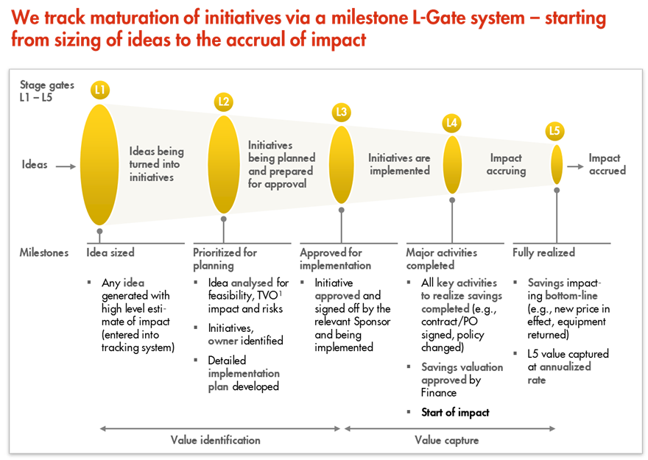
L1 – L5 Gates

